Slide 1
the
GOSPEL
Discipleship
Dynamics in 2 Timothy
UNCHAINED

Slide 2
the
GOSPEL
Mark the Menace
2 Timothy 3:1-9
Discipleship
Dynamics in 2 Timothy
UNCHAINED

Slide 3
The Missing Lady from Croatia
Hedviga Golik
the GOSPEL UNCHAINED x

Slide 4
The Missing Lady from Croatia
Hedviga Golik was last seen by neighbors in 1966, when she would have been 42 years old.
the GOSPEL UNCHAINED x

Slide 5
The Missing Lady from Croatia
Hedviga Golik was last seen by neighbors in 1966, when she would have been 42 years old.
Jadranka Markic: “We all thought that she had just moved out and gone to live with relatives.”
the GOSPEL UNCHAINED x

Slide 6
The ‘last days’ are filled with people
who are filled with self.
the GOSPEL UNCHAINED x

Slide 7
Contextual Notes
the GOSPEL UNCHAINED x

Slide 8
Contextual Notes
Mark this
the GOSPEL UNCHAINED x

Slide 9
Contextual Notes
Mark this
Terrible times
the GOSPEL UNCHAINED x

Slide 10
Contextual Notes
Mark this
Terrible times
Last days
the GOSPEL UNCHAINED x

Slide 11
Contextual Notes
Mark this
Terrible times
Last days
Proto-Gnosticism
the GOSPEL UNCHAINED x

Slide 12
The WAYS of the Proto-Gnostics
‘Last days’ people enthrone the sinful self. (3:1-5)
the GOSPEL UNCHAINED x

Slide 13
The WAYS of the Proto-Gnostics
‘Last days’ people enthrone the sinful self. (3:1-5)
They love the wrong things—and aren’t bothered by it.
the GOSPEL UNCHAINED x

Slide 14
The WAYS of the Proto-Gnostics
‘Last days’ people enthrone the sinful self. (3:1-5)
They love the wrong things—and aren’t bothered by it.
They think the wrong thoughts—and aren’t bothered by it.
the GOSPEL UNCHAINED x

Slide 15
The WAYS of the Proto-Gnostics
‘Last days’ people enthrone the sinful self. (3:1-5)
They love the wrong things—and aren’t bothered by it.
They think the wrong thoughts—and aren’t bothered by it.
They speak the wrong words—and aren’t bothered by it.
the GOSPEL UNCHAINED x

Slide 16
The WAYS of the Proto-Gnostics
‘Last days’ people enthrone the sinful self. (3:1-5)
They love the wrong things—and aren’t bothered by it.
They think the wrong thoughts—and aren’t bothered by it.
They speak the wrong words—and aren’t bothered by it.
They practice the wrong behaviors—and aren’t bothered by it.
the GOSPEL UNCHAINED x

Slide 17
The WAYS of the Proto-Gnostics
‘Last days’ people enthrone the sinful self. (3:1-5)
They practice the wrong spirituality—and aren’t bothered by it.
the GOSPEL UNCHAINED x

Slide 18
The WAYS of the Proto-Gnostics
‘Last days’ people enthrone the sinful self. (3:1-5)
They practice the wrong spirituality—and aren’t bothered by it.
Such people are to be avoided.
the GOSPEL UNCHAINED x

Slide 19
The WILES of the Proto-Gnostics
‘Last days’ people entice the susceptible souls. (3:6-9)
the GOSPEL UNCHAINED x

Slide 20
The WILES of the Proto-Gnostics
‘Last days’ people entice the susceptible souls. (3:6-9)
They are sneaky—for their own fame.
the GOSPEL UNCHAINED x

Slide 21
The WILES of the Proto-Gnostics
‘Last days’ people entice the susceptible souls. (3:6-9)
They are sneaky—for their own fame.
They are manipulative—for their own fame.
the GOSPEL UNCHAINED x

Slide 22
The WILES of the Proto-Gnostics
‘Last days’ people entice the susceptible souls. (3:6-9)
They are sneaky—for their own fame.
They are manipulative—for their own fame.
They are predatory—for their own fame.
the GOSPEL UNCHAINED x

Slide 23
The WILES of the Proto-Gnostics
‘Last days’ people entice the susceptible souls. (3:6-9)
They are sneaky—for their own fame.
They are manipulative—for their own fame.
They are predatory—for their own fame.
They are non-committal—for their own fame.
the GOSPEL UNCHAINED x

Slide 24
The WILES of the Proto-Gnostics
‘Last days’ people entice the susceptible souls. (3:6-9)
They are captivating—for their own fame.
the GOSPEL UNCHAINED x

Slide 25
The WILES of the Proto-Gnostics
‘Last days’ people entice the susceptible souls. (3:6-9)
They are captivating—for their own fame.
Such people will eventually fail.
the GOSPEL UNCHAINED x

Slide 26
The ‘last days’ are filled with people
who are filled with self.
the GOSPEL UNCHAINED x

Slide 27
The Lenten Question
the GOSPEL UNCHAINED x

Slide 28
The Lenten Question
To what extent am I like “them”?
the GOSPEL UNCHAINED x

Slide 29
The Lenten Question
To what extent am I like “them”?
I love the wrong things…
I think the wrong thoughts…
I speak the wrong words…
I practice the wrong behaviors...
I express the wrong passions…
I practice the wrong spirituality…
…and I am not bothered by it.
the GOSPEL UNCHAINED x

Slide 30
The Lenten Question
To what extent am I like “them”?
I love the wrong things…
I think the wrong thoughts…
I speak the wrong words…
I practice the wrong behaviors...
I express the wrong passions…
I practice the wrong spirituality…
…and I am not bothered by it.
I am sneaky…
I am manipulative…
I am predatory…
I am non-committal…
I am captivating…
…for my own fame.
the GOSPEL UNCHAINED x

Slide 31
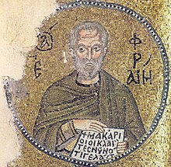
Lenten Prayer of Ephrem the Syrian
“O Lord and Master of my life, take from me a spirit of despondency, sloth, love of money, and idle talk. But give to me, your servant, a spirit of sober-mindedness, humility, patience, and love. Yes, O Lord and King, grant me to see my own sins and not to judge my brother, since you are blessed to the ages. Amen.”
the GOSPEL UNCHAINED x

Slide 32
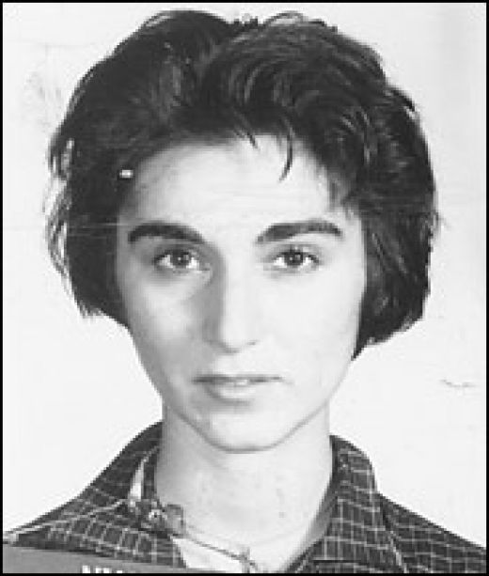
The Mangled Lady from Queens
the GOSPEL UNCHAINED x

Slide 33
The Mangled Lady from Queens
At 3:15 a.m. on March 13, 1964, Winston Moseley stabbed Kitty Genovese twice in the back. Neighbors who heard her screams did very little to help. Winston got away with $49, and Kitty died.
the GOSPEL UNCHAINED x

Slide 34
The Mangled Lady from Queens
At 3:15 a.m. on March 13, 1964, Winston Moseley stabbed Kitty Genovese twice in the back. Neighbors who heard her screams did very little to help. Winston got away with $49, and Kitty died.
“The Bystander Effect”
the GOSPEL UNCHAINED x

Slide 35
The ‘last days’ are filled with people
who are filled with self.
the GOSPEL UNCHAINED x

Slide 36
the
GOSPEL
Discipleship
Dynamics in 2 Timothy
UNCHAINED

